Slide 1

Java Persistence Framework
Presented By-
Riaz Ali
Shikha Gupta
Farzan Ahmad
Emmanuel Imhontu

Slide 2
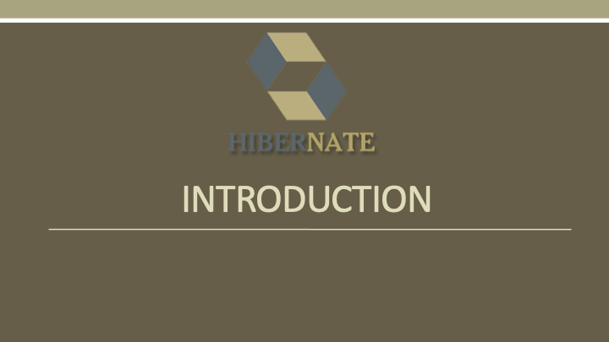

Slide 3
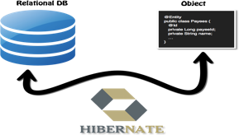
Introduction
It was started in 2001 by Gavin King as an alternative to EJB2 ( Enterprise Java Bean) style entity bean.
Hibernate is a high performance Object/Relational mapping (ORM) framework completely used in Java.
Hibernate also provides query service along with persistence. This gives developers a way to map the object structures in Java classes to relational database tables.
It simplifies the development of Java application to interact with the database.
It is an open source, lightweight, ORM (Object Relational Mapping) tool. Hibernate implements the specifications of JPA (Java Persistence API) for data persistence.

Slide 4
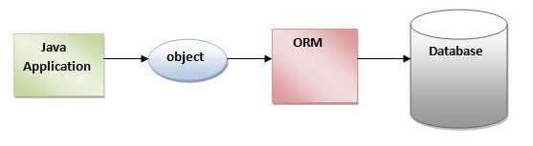
Introduction
ORM (Object/Relational Mapping)Tool
An ORM tool simplifies the data creation, data manipulation and data access. ORM is actually a programming technique for converting data between relational databases and object oriented programming languages.
Some pros of using ORM are the followings
Database implementation is sorted out on its own
Transaction management and automatic key generation
Hides details of SQL queries from object orientation logic
Fast development in application and easy code generation
The ORM tool internally uses the JDBC API to interact with the database.
JPA(Java Persistence API)
Java Persistence API (JPA) is a Java specification that provides certain functionality and standard to ORM tools. The javax.persistence package contains the JPA classes and interfaces.

Slide 5
Advantages of Hibernate Framework
Open Source and Lightweight
Hibernate framework is open source under the LGPL license and lightweight.
Fast Performance
The performance of hibernate framework is fast because cache is internally used in hibernate framework. There are two types of cache in hibernate framework first level cache and second level cache. First level cache is enabled by default.
Database Independent Query
HQL (Hibernate Query Language) is the object-oriented version of SQL. It generates the database
independent queries. So you don't need to write database specific queries. Before Hibernate, if database is
changed for the project, we need to change the SQL query as well that leads to the maintenance problem.
Automatic Table Creation
Hibernate framework provides the facility to create the tables of the database automatically. So there is no need to create tables in the database manually.
Simplifies Complex Join
Fetching data from multiple tables is easy in hibernate framework.
Provides Query Statistics and Database Status
Hibernate supports Query cache and provide statistics about query and database status.

Slide 6
Difference between Hibernate and JDBC
JDBC | Hibernate
JDBC is a persistence technology | Hibernate is a persistence Framework.
In JDBC developer is responsible to taking and closing the connection and also write the SQL statement. | In Hibernate HRS(Hibernate Runtime System) is responsible for taking the connections, creating the statement and releasing the connections.
As table changed or database changed then it’s essential to change object structure as well as to change code written to map table-to-object/object- to-table. | The actual mapping between tables and application objects is done in XML files. If there is change in Database or in any table then the only need to change XML file properties.
Low performance and not scalable | High performance and scalable
it is developer’s responsibility to handle JDBC result set and convert it to Java objects through code to use this persistent data in application. | Hibernate reduces lines of code by maintaining object-table mapping itself and returns result to application in form of Java objects.

Slide 7
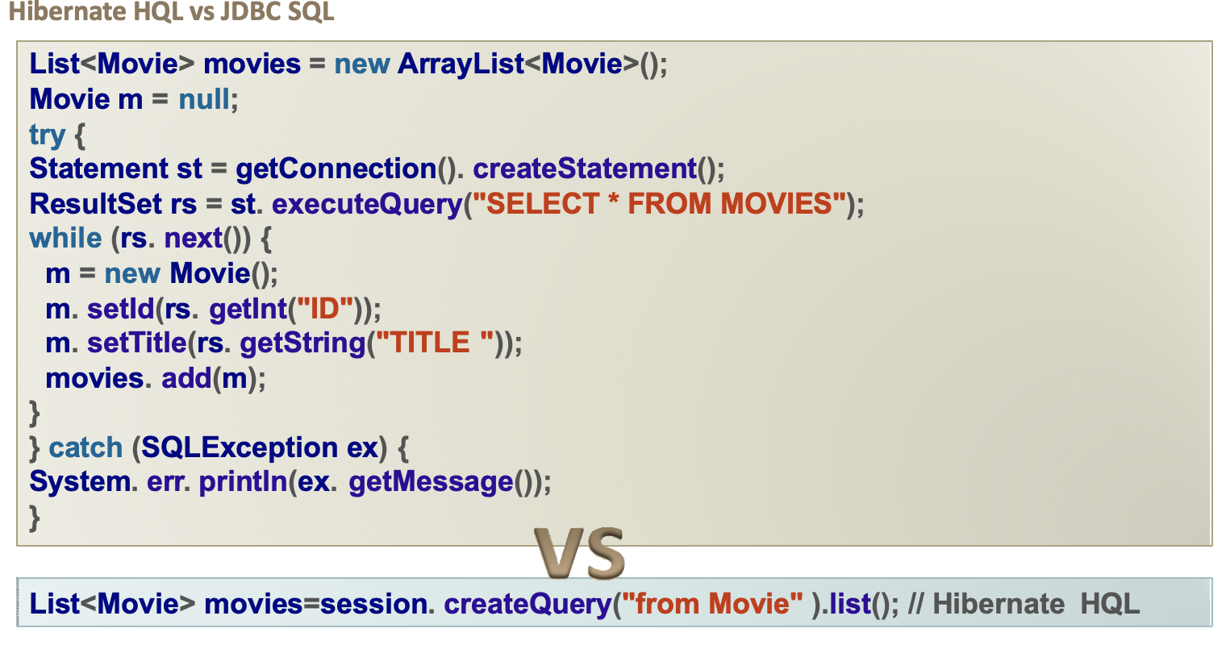
Difference between Hibernate HQL and JDBC SQL

Slide 8
Hibernate Components...
Hibernate has three different components:
Entities – Entities are classes mapped by Hibernate to relational database tables. These are simple Java classes.
Configuration Metadata – This contains the information about how to map the entities to relational database tables. Java provides the way of annotations, but traditional hibernate configuration provides an XML based configuration file. This information is used at runtime to map the data store and back to Java objects.
Hibernate Query Language (HQL) – Queries send to database in hibernate can be formulated in Native SQL or Hibenate’s own query language. These queries are translated at runtime into the currently used dialect of the chosen product.

Slide 9
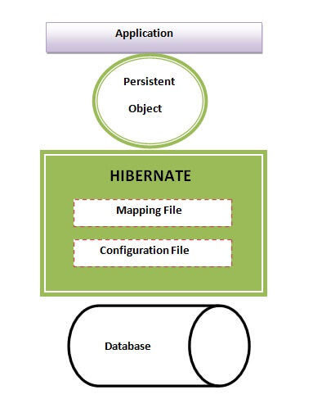
Hibernate Architecture
The Hibernate architecture is categorized in four layers.
Java Application Layer
Hibernate Framework Layer
Backhand API Layer
Database Layer

Slide 10
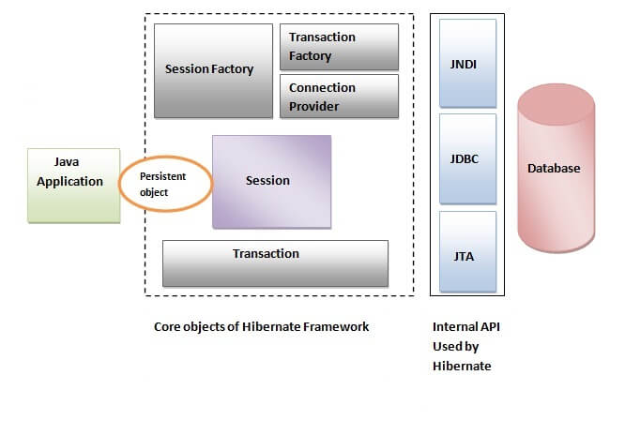
This is the high level architecture of Hibernate with mapping file and configuration file.
High Level Architecture
Hibernate framework uses many objects such as
session factory,
session,
transaction etc.
along with existing Java API such as
JDBC (Java Database Connectivity)
JTA (Java Transaction API)
JNDI (Java Naming Directory Interface).

Slide 11
Elements of Hibernate Architecture
SessionFactory
The SessionFactory is a factory of session and client of ConnectionProvider. It holds second level cache (optional) of data. The org.hibernate.SessionFactory interface provides factory method to get the object of Session.
Session
The session object provides an interface between the application and data stored in the database. It is a short-lived object and wraps the JDBC connection. It is factory of Transaction, Query and Criteria. It holds a first-level cache (mandatory) of data. The org.hibernate.Session interface provides methods to insert, update and delete the object. It also provides factory methods for Transaction, Query and Criteria.
Transaction
The transaction object specifies the atomic unit of work. It is optional. The org.hibernate.Transaction interface provides methods for transaction management.

Slide 12
Elements of Hibernate Architecture..
ConnectionProvider
It is a factory of JDBC connections. It abstracts the application from DriverManager or DataSource. It is optional.
TransactionFactory
It is a factory of Transaction. It is optional.

Slide 13
Alternative of Hibernate Framework
There are several persistent frameworks and ORM options in Java. A persistent framework is an ORM service that stores and retrieves objects into a relational database.
Enterprise JavaBeans Entity Beans
Java Data Objects
Castor
TopLink
Spring DAO
Hibernate
And many more

Slide 14
Hibernate Supported databases
HSQL Database Engine
DB2/NT, MySQL
PostgreSQL
FrontBase
Oracle
MongoDB
Microsoft SQL Server Database
Sybase SQL Server
Informix Dynamic Server

Slide 15
Outline of Workshop
Download and install all the softwares mentioned in documentation for workshop.
Add all jar Dependencies files
Add jar Dependencies to pom.xml
Creating the hibernate.cfg.xml
Creating the JPA Entity Class(Persistent class)
Create a Hibernate configuration file - Java Configuration
Create Student Class,create object
Open the Database ,create a schema for student class
Create the Main class and Run an Application
After run the application ,student class objects store in database

Slide 16
Resources and Links
https://hibernate.org
https://www.tutorialspoint.com/hibernate/index.htm
https://examples.javacodegeeks.com/enterprise-java/hibernate
https://www.javaguides.net/
https://www.a2hosting.com/kb/developer-corner/mysql/connect-to-mysql-from-the-command-line
http://www.gontu.org

Slide 17
TACK!!

